Slide 1







Capstone Project
Tami McManus
May 24, 2024

Slide 2



OUTLINE
Executive Summary
Introduction
Methodology
Results
Charts
Dashboard
Findings
Conclusion

Slide 3

EXECUTIVE SUMMARY
Data related to job postings and training portals was analyzed to identify technology trends:
Top technologies remain largely the same, with changes appearing in the ranking of the top technologies
Training programs and mix of resources should be evaluated, but adjustments will likely be small
Survey responses were heavily skewed by gender and warrant further review for accuracy
Further analysis of resource demand may be useful

Slide 4

INTRODUCTION
To remain competitive, we need to keep pace with changing technologies. This is done by regularly analyzing data related to job postings and training portals to identify trends involving:
Popular Programming Languages
Popular Database Platforms
As well as general information regarding:
Demographics
Job Locations
Salary Information

Slide 5

METHODOLOGY
Job Posting data pulled from an API provided by GitHub to pull Survey results data
Salary data scraped from an IBM website
Data analysis performed with Python in Jupyter Lab
Data Visualizations created using Tableau

Slide 6

RESULTS – Table of Contents
Programming Language Trends
Findings and Implications
Database Trends
Findings and Implications
Dashboards
Current Technology Trends
Future Technology Trends
Demographics

Slide 7
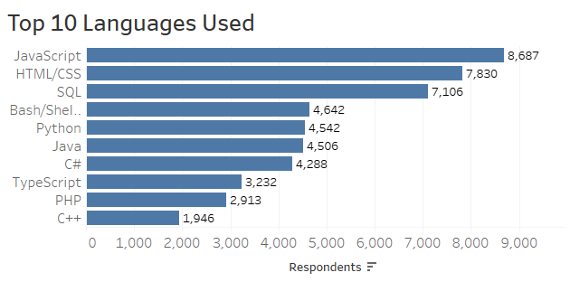
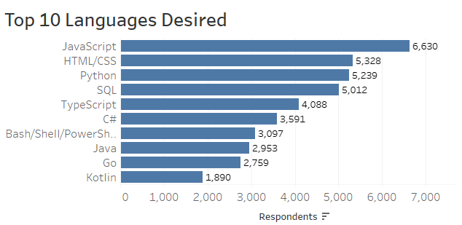
PROGRAMMING LANGUAGE TRENDS
Current Year
Next Year

Slide 8

PROGRAMMING LANGUAGE TRENDS – FINDINGS & IMPLICATIONS
 | Finding | Recommendation
 | JavaScript and HTML/CSS remain the top languages | Continue training and retention programs
 | Python, C#, and TypeScript move up the list | Increase training and retention programs
 | Go and Kotlin are added to the top 10 | Increase training and retention programs
 | SQL and Bash/Shell/PowerShell move down the list | Decrease training and retention programs
 | PHP and C++ fall off the list | Decrease training and retention programs

Slide 9
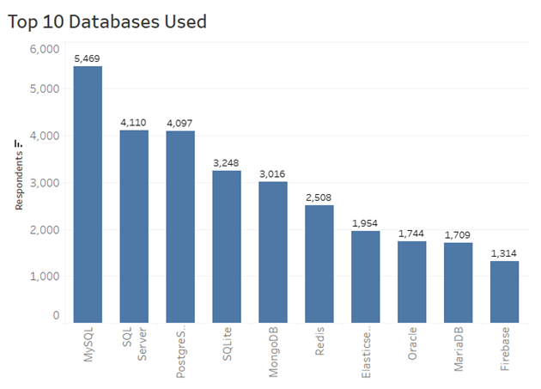
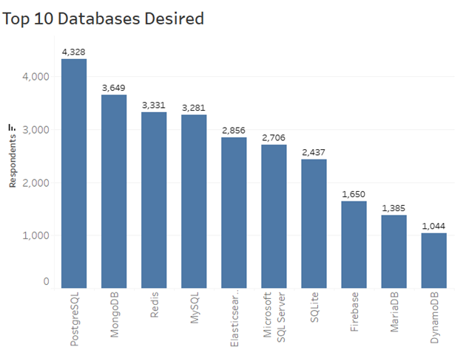
DATABASE TRENDS
Current Year
Next Year

Slide 10
PROGRAMMING LANGUAGE TRENDS – FINDINGS & IMPLICATIONS
 | Finding | Recommendation
 | There is no crossover in the top 3 spots | Review validity of findings
 | PostgreSQL, MongoDB, Redis, ElastiSearch, Firebase move up the list | Increase training and retention programs
 | DynamoDB added to the top 10 | Increase training and retention programs
 | MySQL, Microsoft SQL Server, SQLite move down the list | Decrease training and retention programs
 | Oracle falls off the list | Decrease training and retention programs

Slide 11
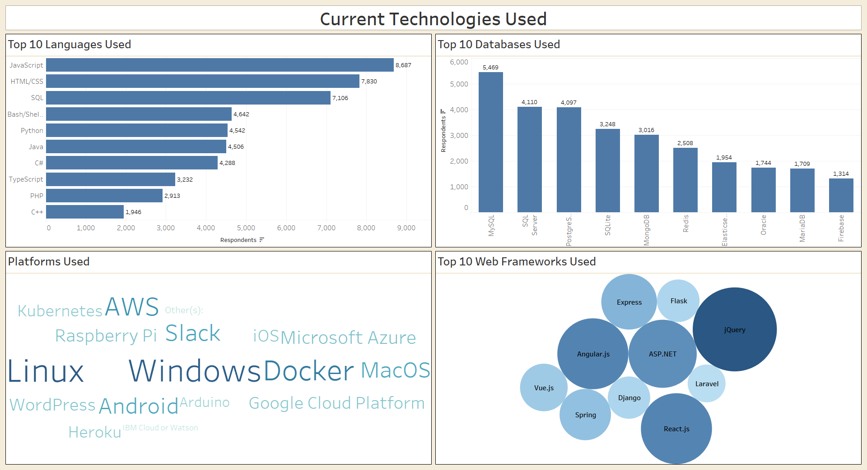
CURRENT TECH USAGE

Slide 12
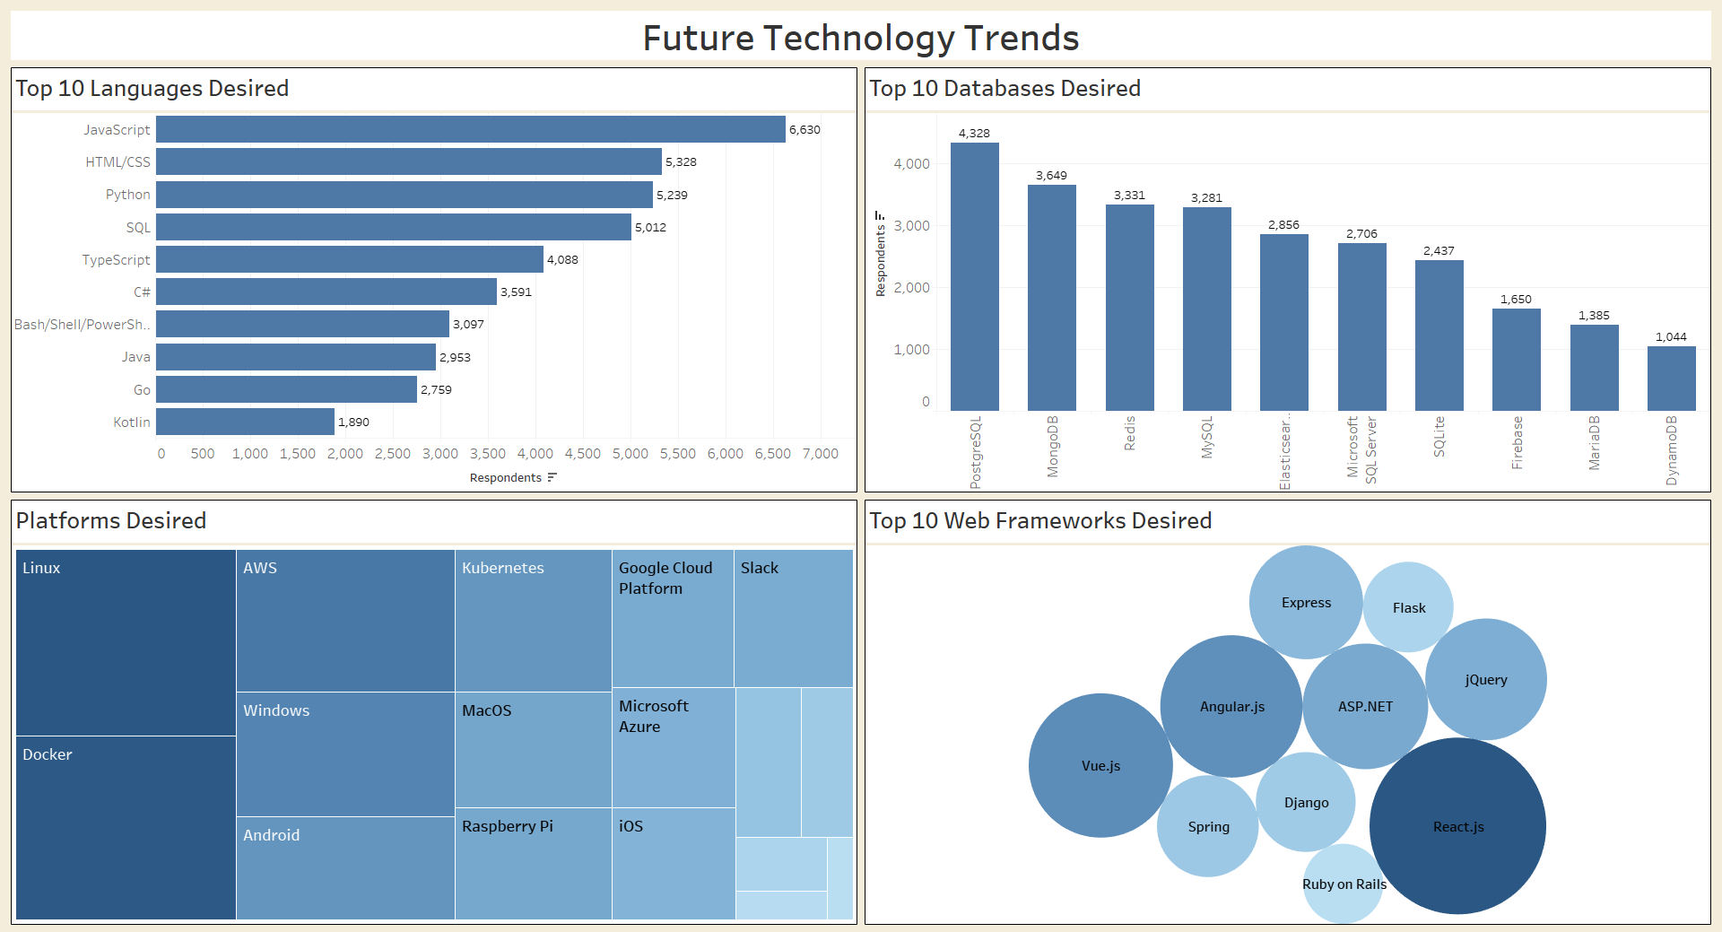
FUTURE TECHNOLOGY USAGE

Slide 13
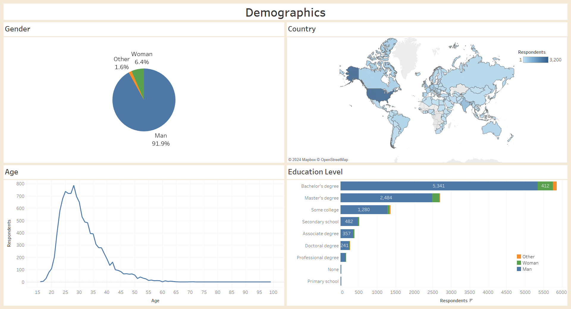
DEMOGRAPHICS

Slide 14

FINDINGS
The top 10 Programming Languages and Databases are largely unchanged, although the rankings are volatile
Survey respondents were overwhelming male (> 93%)
Survey respondents were generally younger

Slide 15

CONCLUSION
While training programs and resource availability should be reviewed, it is unlikely that large changes will need to be made
Additional validation may be required to ensure that the survey respondents are representative of the technology workforce

